Slide 1
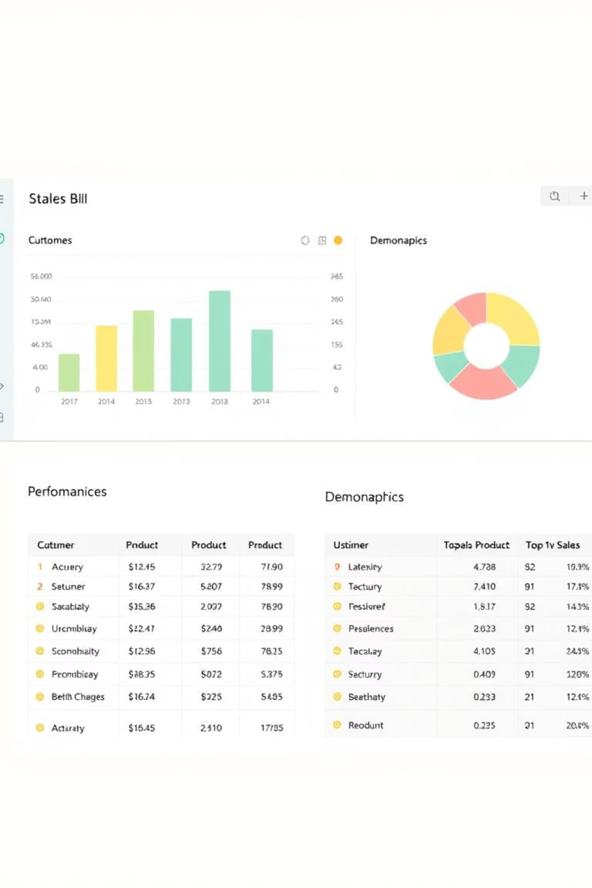

Unlocking E-commerce Insights with Power BI
This presentation outlines our approach to leveraging Power BI for in-depth e-commerce data analysis, transforming raw data into actionable business intelligence.
by Smit More

Slide 2

Project Overview: E-commerce Data Analytics
Core Objective
Key Deliverable
Identify best-selling products and key sales trends.
Interactive Power BI dashboard for strategic decisions.
Target Outcome
Actionable insights for revenue growth and optimization.

Slide 3

Data Acquisition and Preparation
1
Data Sourcing
Consolidate transactional and customer data.
2
Data Cleaning
Ensure accuracy and consistency of records.
3
Data Modeling
Structure data for efficient analysis in Power BI.

Slide 4





Key Analytical Skills Utilized
Data Cleaning
Transforming raw data into usable formats.
DAX Formulas
Complex calculations for rich insights.
Trend Analysis
Identifying patterns and predicting future sales.
Business Storytelling
Communicating findings effectively to stakeholders.

Slide 5
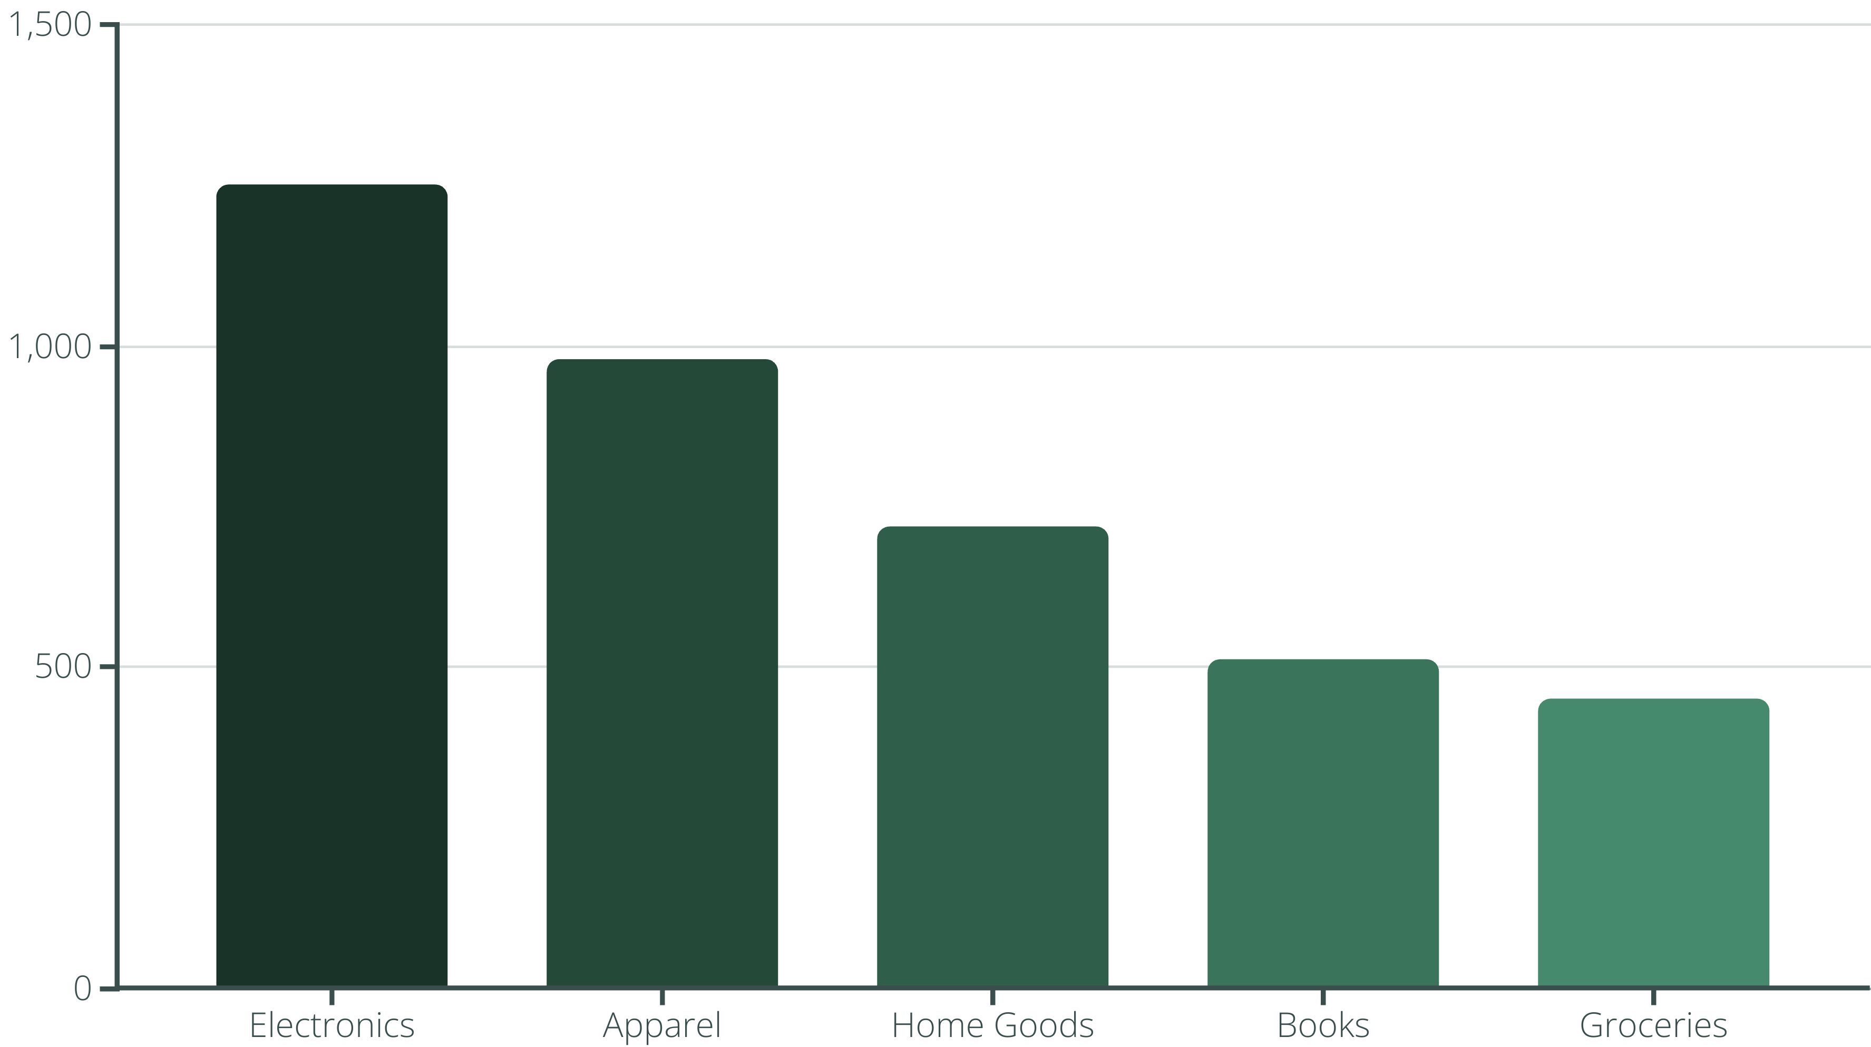
Top-Selling Products by Category
Our analysis reveals Electronics as the leading category, followed by Apparel. This insight guides inventory and marketing strategies.

Slide 6
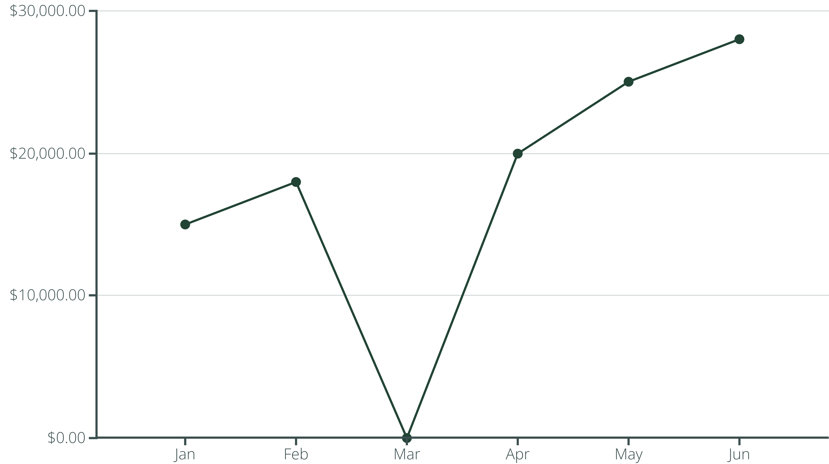
Sales Trends and Seasonal Analysis
Line chart shows a steady upward sales trend, with peaks indicating seasonal opportunities for targeted promotions.

Slide 7

Interactive Dashboard: A Business Tool
Key Features
Dynamic filters for deep dives.
Customizable visuals for specific needs.
Real-time data refresh capability.
Benefits
Empower quick, informed decisions.
Identify growth opportunities instantly.
Monitor KPIs with ease.

Slide 8

Key Takeaways and Next Steps
Actionable Insights
Data-driven decisions enhance e-commerce performance.
Continuous Monitoring
Regular dashboard use for ongoing optimization.
Future Expansion
Integrate more data sources for holistic view.

